Slide 1

Tabletop Tablet Rollout Findings

Slide 2
Summary
To measure tablet effectiveness, we conducted a test launch with 50 participants simulating a normal dining experience. Participants completed the test launch by answering a 15-question digital survey regarding their overall experience using the tablets, wait time, and order accuracy.

Slide 3
Overview
Our test launch goal was to measure tablet effectiveness and a number of other factors including:
Percentage of dish accuracy
Customer satisfaction rates
Table wait time
Ease of tablet navigation
Ease of check out process using tablet
Percentage of technical tablet related issues

Slide 4
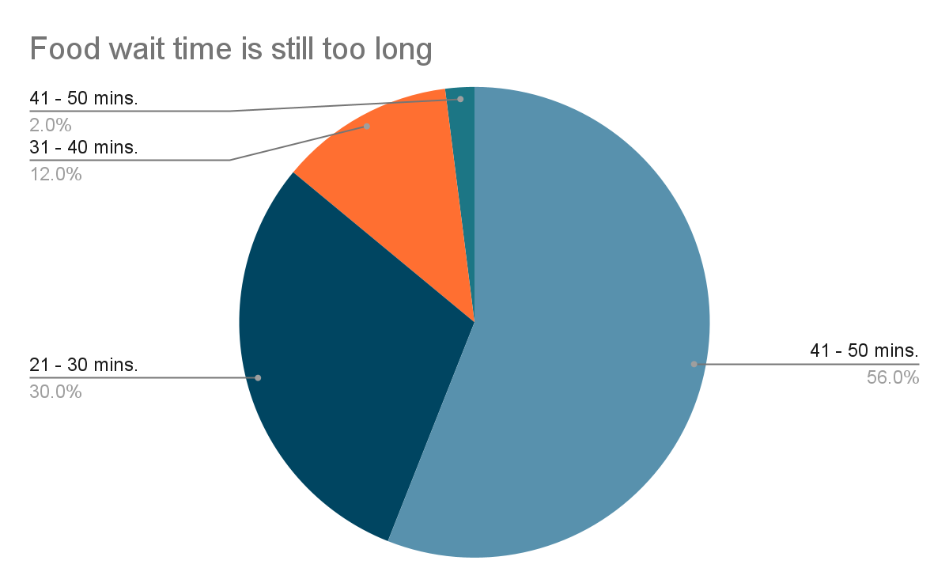
Findings

Slide 5
Next Steps
A cash payment option via the tablets needs to be improved. A number of customers reported prolonged checkout time associated with wanting to pay cash and increased server wait time to do so.
Pursuing a streamlined cash checkout option that stays within the 1 minute checkout criteria will resolve this issue.

Slide 6
Next Steps
Food wait time should also be improved upon. A decrease in overall food wait time will naturally decrease table wait time because table turnover time will increase,
A decrease in food wait time will also increase overall customer satisfaction and daily customer count percentage.

